Slide 1



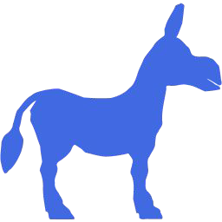


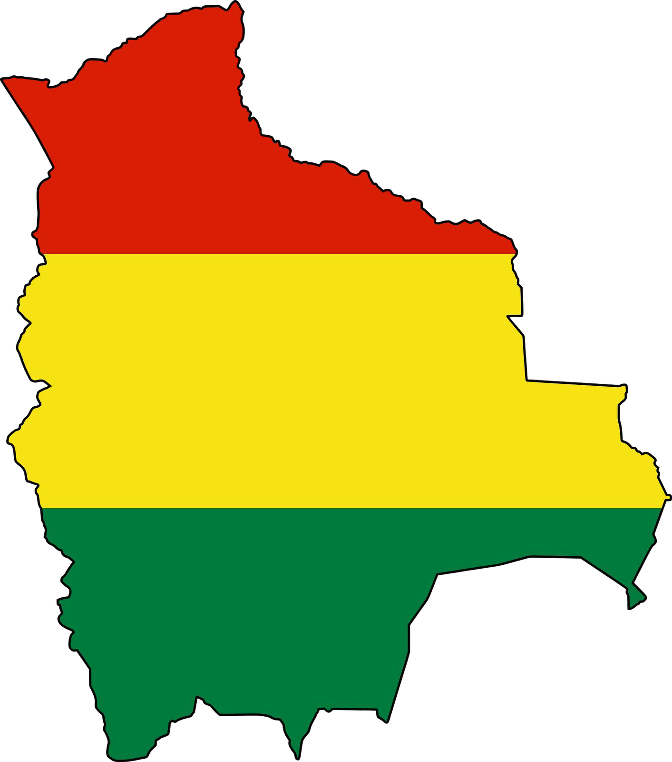

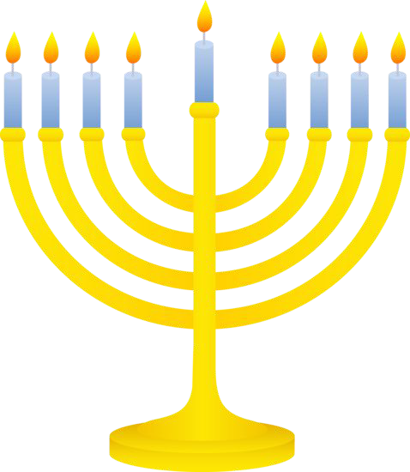



Bitcoin is
neutral
@anilsaidso

Slide 2
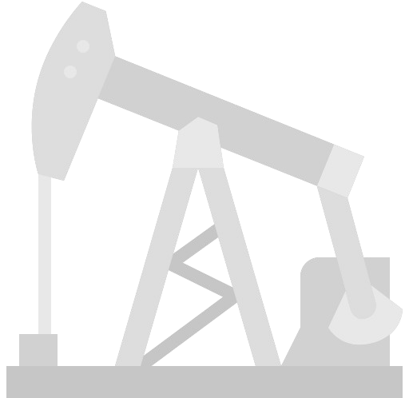



Which cartel do you belong to?
A neutral
commodity
No one controls my rate of issuance.

Slide 3


Do you want to try cloning?
A neutral
money
I can’t.
I’m provably scarce.

Slide 4

What are your licensing terms?
A neutral
software
I’m open source.

Slide 5


What’s your Q3 forecast?
A neutral
platform
I have no shareholder obligations.

Slide 6


Welcome to the club.
A neutral
protocol
Thanks!

Slide 7


How do you restrict users?
A neutral
payment rail
I can’t.
I’m permissionless.

Slide 8





Cool, we’re neutral too!
Yea!

Slide 9

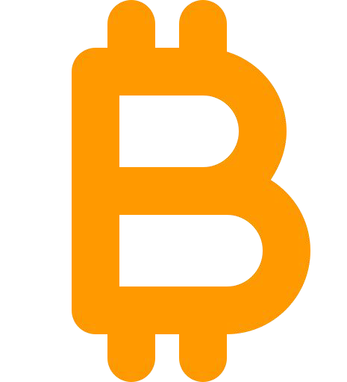

Who is your creator?
theologically
agnostic
Satoshi Nakamoto.

Slide 10
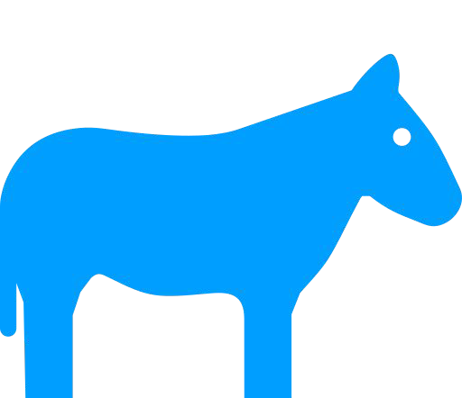
politically
agnostic
Join us!
Sorry, I’m apolitical.
No, join us!

Slide 11

I forbid you within my borders.
ionally
agnostic
Jurisdict-
What’s a border?

Slide 12


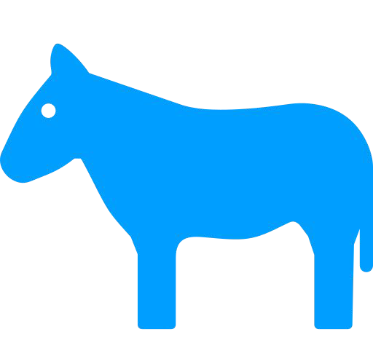
Bitcoin is ^{for everyo}(except^{n}Craig W^{e}right)
yay!
Fine!
yay!
yay!
yay!
@anilsaidso

